Slide 1
Health Insurance Analysis and Prediction price using ML model
Abstract:- This Project is for the doing the basic exploration and analysis for the health insurance data set and predict the price of insurance amount using various ML model and finding the best model for the prediction of price.
From :-Lokesh R
BE Graduate (AE)
Aspiring Data scientist

Slide 2
Health insurance is a contract between a company and a consumer. The company agrees to pay all or some of the insured person's healthcare costs in return for payment of a monthly premium.
Health insurance is a necessity nowadays, and almost every individual is linked with a government or private health insurance company. Factors determining the amount of insurance vary from company to company. Also people in rural areas are unaware of the fact that the government of India provide free health insurance to those below poverty line. It is very complex method and some rural people either buy some private health insurance or do not invest money in health insurance at all. Apart from this people can be fooled easily about the amount of the insurance and may unnecessarily buy some expensive health insurance.
The dataset which was taken for the analysis is from Kaggle:- “kaggle datasets download -d annetxu/health-insurance-cost-prediction”
The Data set consist of missing values which was imputed using the suitable techniques.
The Dataset was an regression model which means the output variable is an continues variable so to predict the value regression model can be used.
For the exploration of the data was done by using the python libraries like Numpy (For numerical operation),Pandas(For Dealing with the Data Set), Matplotlib(For plotting graph), seaborn(Data visualization ), plotly(For data visualization),and sklearn (For Feature Engineering and Machine learning ).

Slide 3
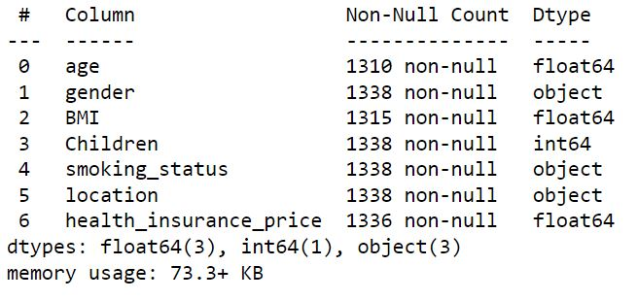
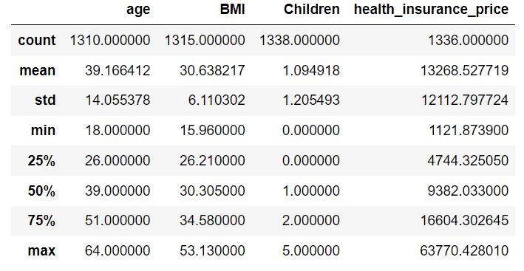
To find the basic description and info which helps us to find out the values which are enter are which dtype and null values are enter in the any other form like .,0,etc.
From the above image we can see that there are some null values present in the dataset and there are no enters other that null .
next to deal with missing values and find out missing values and any wrong entry pandas library was use and to impute the missing value fancy imputer was use because data set imputed by this method was showing good accuracy compare to other method.

Slide 4
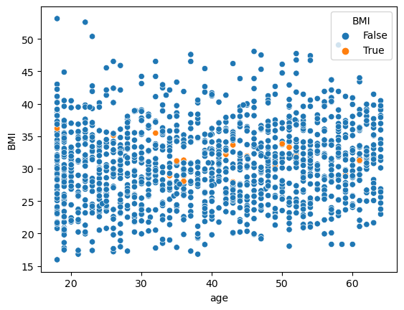
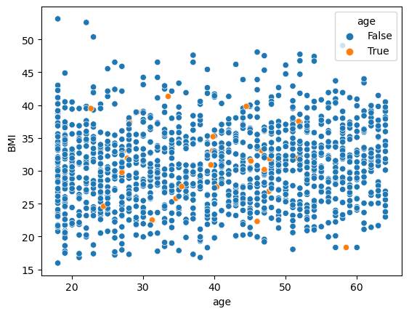
From the plot we can see that the missing values are imputed are random and because of which the accuracy of the model will be imputed when compared to the other kind of imputing methods.

Slide 5
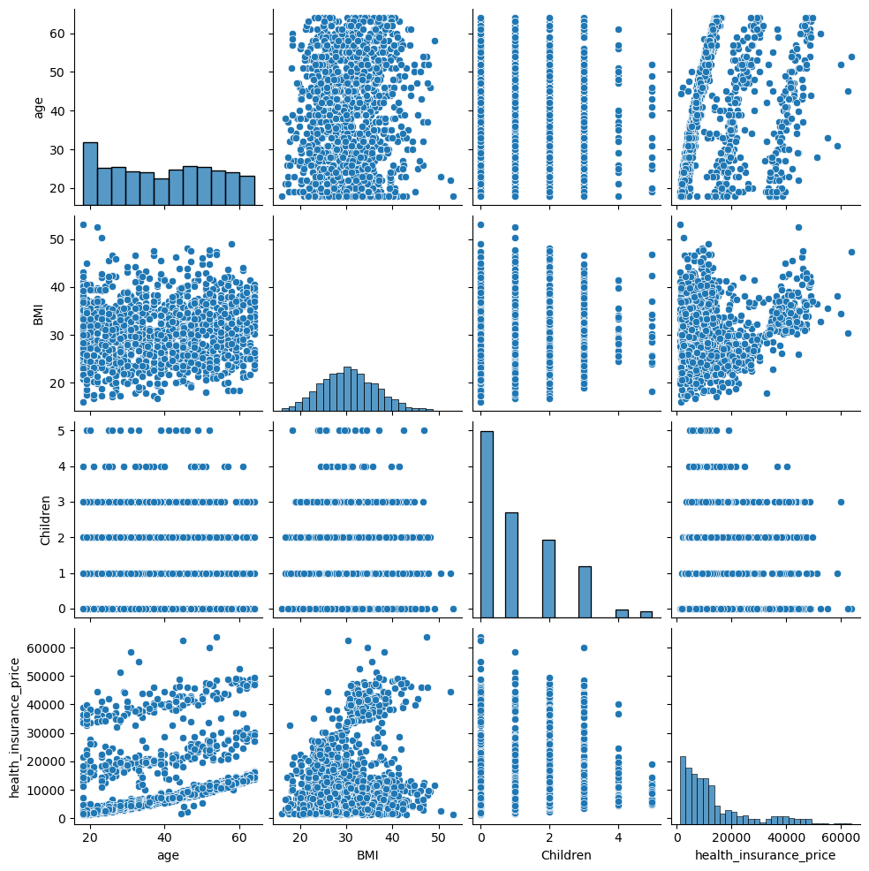
Hypothesis Analysis :-
From the above plot we can see that there is no linear relation between the variable and to run the logistic reggretion there are soma assumption which as to be satisfied which are variable should be linear relation , No high co relation among the variable etc .
So the data don't follow the above assumption so linear reggretion cannot be used for the prediction of the cost.

Slide 6
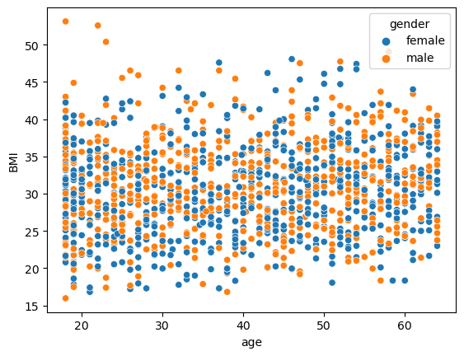
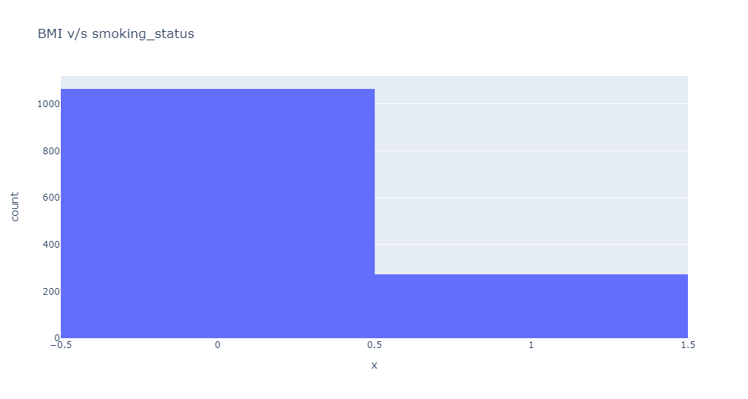
From the plot we can see that there is no relation b/w age ,BMI and gender .
From the plot we can see that there is large number of people with non smoker .

Slide 7
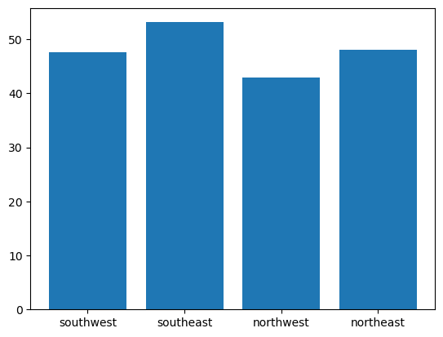
From the plot we can see that most of the people are form southeast and least are from northwest
From the above analysis we can say that we cannot use the linear regression because they don’t satisfy assumption of the linear regression so for the prediction of the price we going use other kinds of regression model like SCM, Decision tree , randomforest etc.
For checking the accuracy of the regression model there are some of the method to check which are
1)Mean absolute error(Less the value good the model is)(MAE).
2)Mean square error(Less the value good the model is)(MSE).
3)R^2 score(Near to 1 good the model is)(R^2).
4)Radjested ^2(Near to 1 good the model is)(Radj^2).
5)Root mean square error(Less the value good the model is)(RMSE).

Slide 8
1)Support vector machine:-svm.SVR(kernel='linear‘ , C=1000 , gamma=1)
Here Kernel is division model ,C=Regularization Parameter , gamma=Kernel Coefficient
MAE : 3556.45
MSE: 46754040.11
RMSE: 6837.69
R^2: 0.679
Radj^2: 0.679
2) Decision Tree Regressor:- DecisionTreeRegressor(criterion='absolute_error',max_depth= 5)
Where Criterion is method for selecting the variables from data ,max_depth =number of trees
MAE : 2616.07
MSE: 34606112.14
RMSE: 5882.69
R^2: 0.762
Radj^2: 0.671

Slide 9
3) Random Forest Regressor :- RandomForestRegressor(criterion='squared_error',max_depth=4)
Where criterion is the precition of the feture ,max_depth= model fitting.
MAE : 2777.98
MSE: 26075344.34
RMSE: 5106.40
R^2: 0.821
Radj^2: 0.820
4) XGBoost :- xgb.XGBRegressor(max_depth=3,n_estimators=10)
Where Here max_depth is fitting the model and estimators is number of trees.
MAE : 2591.77
MSE: 25306711.64
RMSE: 5030.577
R^2: 0.826
Radj^2: 0.825

Slide 10
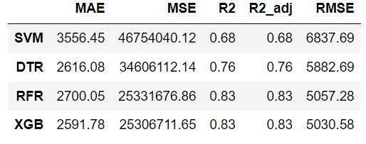
Conclusion:-
From the above result we can see that XGBOOST gives us the minimum RMSE and MAE, maximum r2 and r2 adjusted so XGBOOST has the best prediction in that particular parameter given .

